Slide 1


Chunking in sequence learning
Jack Gabel, Sol Markman, Quilee Simeon, Hokyung Sung

Slide 2
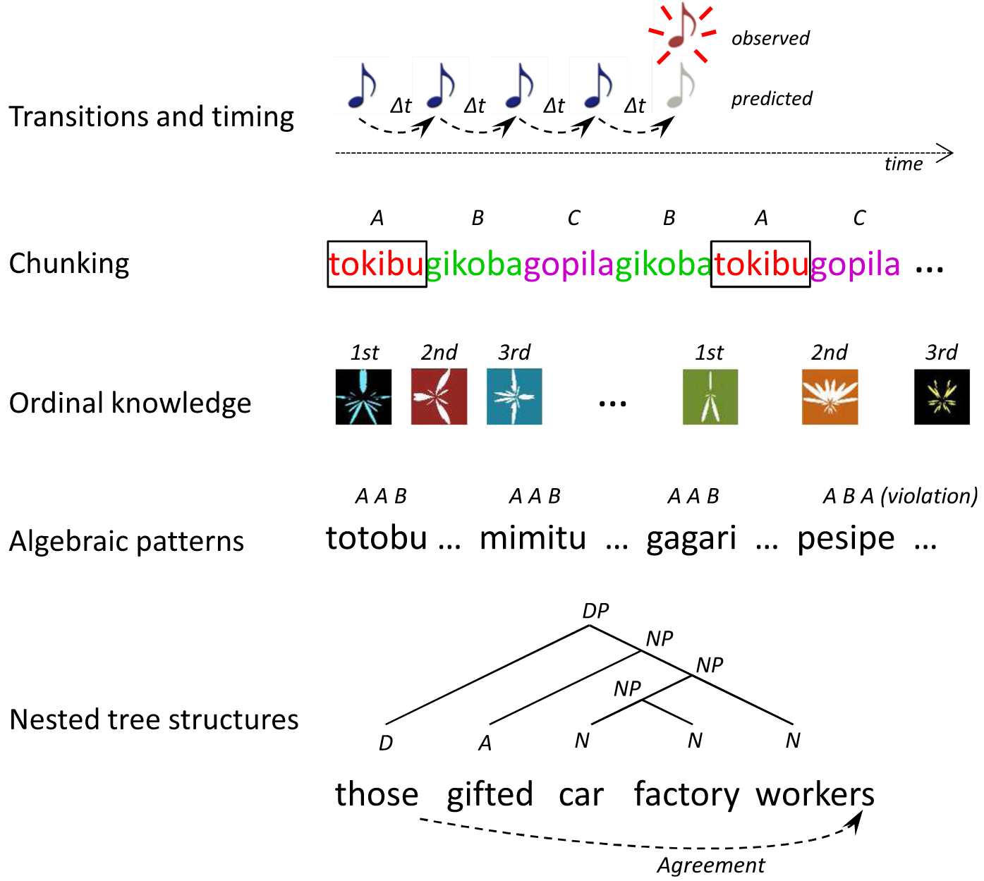
Learning and remembering sequences
How does the brain encode sequences?
Five levels of abstraction (Dehaene et al. 2015):
Neural evidence
Transitions & timing
EEG/MEG: Mismatch and omission responses
Chunking
EEG evidence of remembering global sequences (P3b wave)
Learning motor sequences: PFC and BG neurons initially spike in response to every action. Later only for the first and last.
fMRI evidence for “chunks of chunks”?
Ordinal knowledge
PFC: 44% neurons tuned to serial position when monkeys learned sequences of 3
Conjunctive cells: ordinality + identity
Notes:
MMR and OR: “sensory prediction errors”
MMR: expect abab, see abaa → activity at last item
OR: expect abab, see aba_ → “”
Fast, automatic (even when falling asleep, or during a coma!! e.g.). Sensory cortices
“Global” chunk EEG activity: Slower, less automatic (have to be conscious & paying attention)
Expect aaab, see aaaa → slow novelty response
None of these really explain how the brain represents chunks

Slide 3
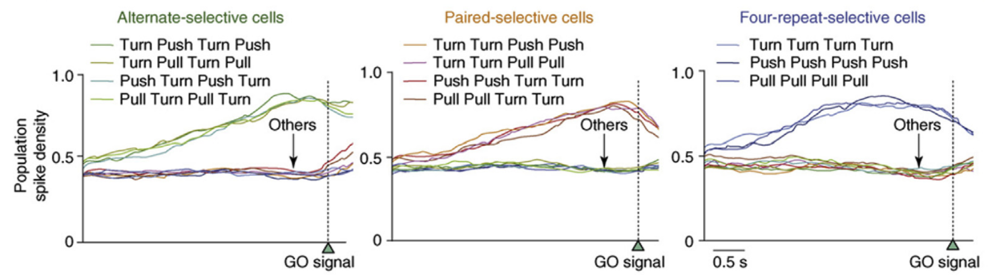
Learning and remembering sequences
How does the brain encode sequences?
Neural evidence
Algebraic patterns
Monkeys learning sequences of 4 actions: neurons tuned to repetition (AAAA), alternation (ABAB), pairs (AABB)
Shima et al. (2007)
Nested tree structures
‘‘he [drove [to [this [big house]]]’’ → ‘‘he drove”... + “to this one,’’ ‘‘to it,’’ ‘‘there’’; ‘‘he did.’’
Mostly from language network fMRI studies: e.g. IFG (Brodmann’s area 45)
Notes:
E.g. when learning a fake language IFG responds when nested grammar rules are used but not when arbitrary rules are used
Nested tree structures are not unique to language

Slide 4

The Simon Game

Slide 5
Measures of sequence complexity
The Lempel-Ziv (LZ) complexity of a sequence measures how many different "phrases" or patterns you encounter as you read through the sequence from start to finish.
Each time you encounter a new pattern that hasn't been seen before in the sequence, the complexity count increases.
This measure gives us an idea of the randomness or the structure within the sequence.
Sequences with a certain regularity do not have a too large complexity, and the complexity grows as the sequence grows in length and irregularity.
Notes:
The core algorithm, which involves searching for unique substrings and updating indices accordingly, remains the same regardless of the alphabet size of the sequence. For sequences derived from an alphabet larger than binary, you simply ensure that the sequence you input into the function is in a form where each symbol (a.k.a character) is distinct and treated as such by the algorithm. No conversion to a binary format is necessary, as the algorithm does not rely on the nature of the symbols/characters but rather on the structure and repetition of patterns.

Slide 6
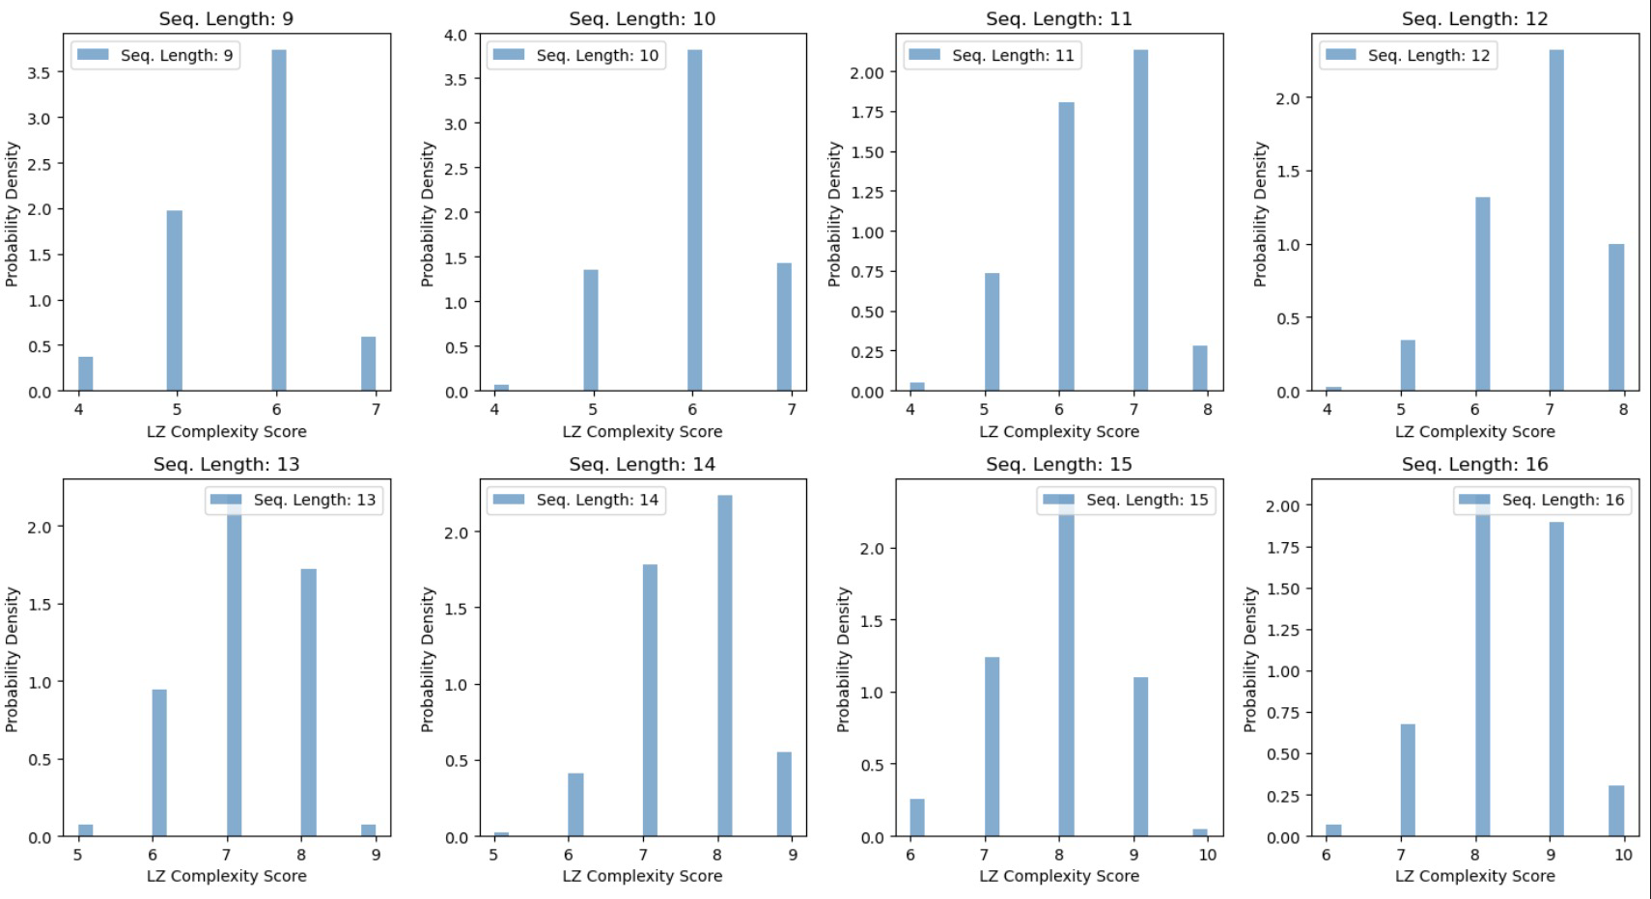
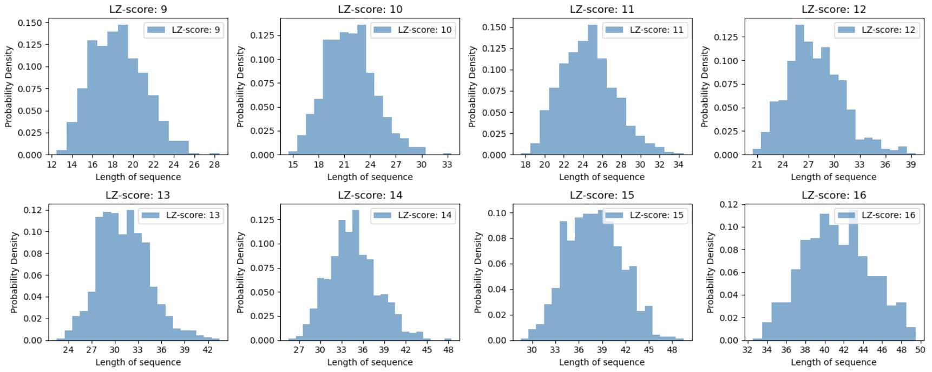
Predictions based on LZ-complexity coding scheme
Statistics of Simon’s game sequences
We generated 10,000 sequences ranging in length from in length from 1 to 40 by randomly sampling characters from {B, G, R, Y} . e.g. YYRYBYBG. We calculate the LZ complexity of all sequences. The simulation data allows us to approximate the joint and conditional distributions of LZ-complexity and sequence length.

Slide 7
Predictions based on LZ-complexity coding scheme
Hypothesis: When people achieve long sequences in the Simons game, the LZ-complexity of those sequences is lower than the expected value given that sequence length.
Prediction: We expect that most of the human data from the long-sequence tail would fall below the expected value of LZ-complexity.
Individuals remember low LZ-complexity sequences better than they do high LZ-complexity ones.
In essence, people remember more "chunkable" sequences better than less "chunkable" ones. Of course, this statement relies on us defining "chunkability" as inverse LZ-complexity.
Notes:
The human data could be viewed as a biased sample from the full distribution of the simulated data (i.i.d random sequences).
We expect that most of the human data would fall below the best-fit line from regression on the simulated data. Our hypotheses suggest that we should see higher LZ-complexities at shorter sequence lengths (caveman translation: less chunkable sequence make game harder); and lower LZ-complexities at longer sequences (caveman translation: more chunkable sequence make game easier).

Slide 8
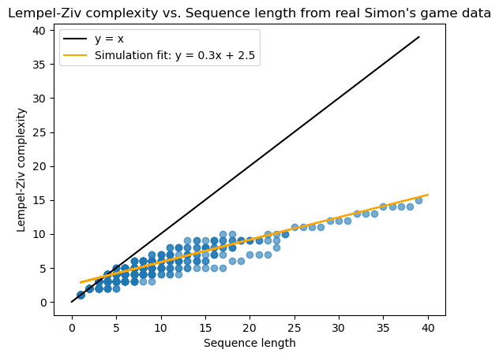
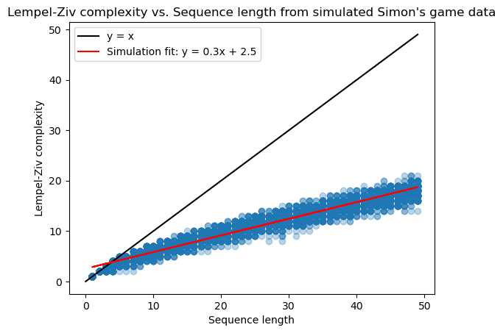
Preliminary results and model comparison
Number of points above the line: 104
Number of points below the line: 156
P-value from the sign test: 0.00151
Reject the null hypothesis: Significant difference in the number of points above vs. below the line.
Number of points above the line: 37
Number of points below the line: 25
P-value from the sign test: 0.162
Fail to reject the null hypothesis: No significant difference in the number of points above vs. below the line.
Sign test
“long” sequences
“long” sequences
Notes:
**Thoughts:** We saw earlier that LZ-complexity is linearly proportional to the length of the sequence. The linear relationship means people with higher memory capacity can score higher in the Simons game. This is almost like stating the obvious. But what these hypotheses claim is that, controlling for individual memory capacity (i.e. asked to remember a sequence of some fixed length), individuals remember low LZ-complexity sequences better than they do high LZ-complexity ones. In essence, people remember more "chunkable" sequences better than less "chunkable" ones. This may also seem like stating something obvious. Of course, this statement relies on us _defining_ "chunkability" as inverse LZ-complexity.

Slide 9
Coding schemes and “chunkability”
Recall: LZ complexity is the number of different phrases/patterns encountered as a sequence is viewed as a stream.
This implicitly defines a coding scheme whereby sequences are constructed by stitching together these phrases/patterns.
We operationally define a chunk as one such phrase/pattern.
We also try out other, custom defined coding schemes.
Underlying assumption: higher complexity/size = higher load on working memory

Slide 10
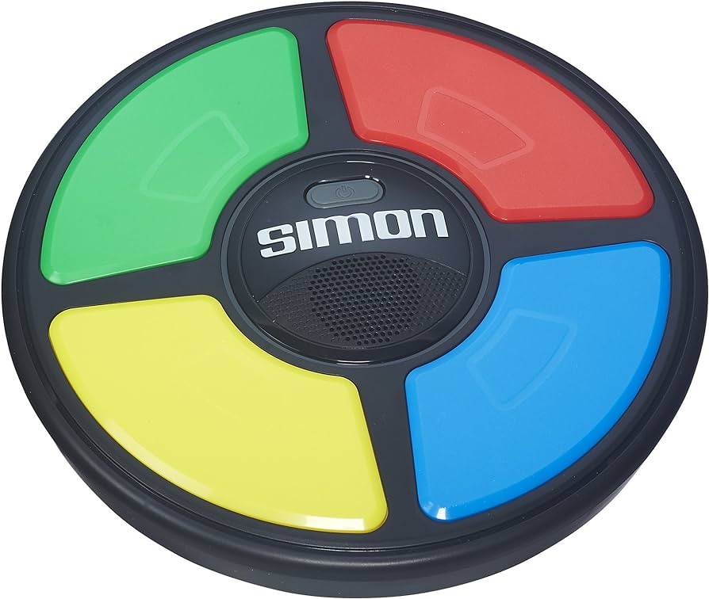
Coding schemes and “chunkability”
Custom coding scheme
Repeats: [subsequence]^n, size = size(subsequence) + 1
Single color: RRRRR → [R]^5, size=2
Multicolor: RGBRGBRGB → [RGB]^3, size=3+1=4
Nested: RRGGGRRGGG → [ [R]^2 [G]^3 ]^2
Alternation: [XYX], size = 2
Note that XYXY is a repeat [XY]^2, or an alternation plus one [XYX]X, in both cases size=3
Cycles: [start, direction, length], size = 3
GRBYGR = (G, CW, 6)
Hierarchical: 1a, then 1b, … no item can belong to multiple chunks
Additional effect: Compression by repetition: size(c, i+1) = λ^n * size(c, i), λ < 1
n = # of presentations of chunk c
The more you’ve repeated a chunk, the more memorable it gets

Slide 11
Behavioral experiment design & considerations
Goal: test hypotheses about coding schemes on behavior data
To compare, we take the length of the code after the chunking a sequence as the “complexity” of the sequence, which generates “hypothesis-predicted difficulty ratings” per sequence
We obtain empirical difficulty ratings from behavioral performance on the sequences
Determine which hypothesis-predicted difficulty rating best captures performance
Ideally, we would get unlimited data on randomly generated sequences
Problem: the space of sequences grows exponentially and the time it takes to play a sequence takes O(n^2) time for sequence length n

Slide 12
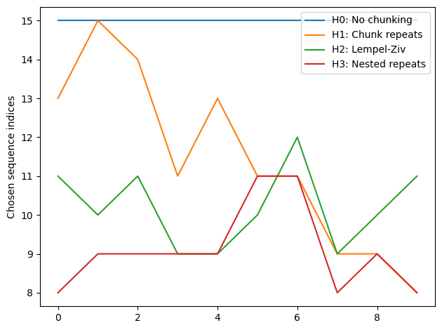
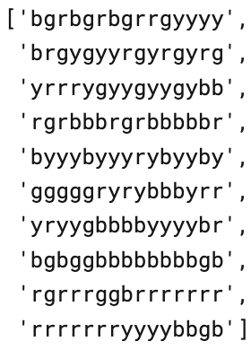
Behavioral experiment design & considerations
To find the set of stimuli that can best differentiate the hypotheses,
We generate 10,000 sequences of length 15
Obtain hypotheses-predicted ratings for each sequence
Perform hierarchical clustering on the matrix of size (# sequence X # hypotheses)
Choose m sequences from each cluster

Slide 13
Neural questions
How are sequences represented in the brain?
How is chunking implemented neurally?
*We will focus on delay period and simple chunks (repeats) for neural models
*May modify neural hypotheses based on behavioral results

Slide 14
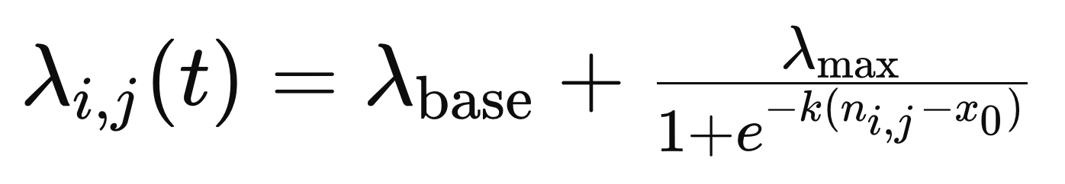
Slot Model
Slot model’s constraint:
Number of slots
How to encode chunking of repeats in the slot model?
Firing rate (sampled from a poisson distribution)
n = # of repeats
1
2
3
4

Slide 15
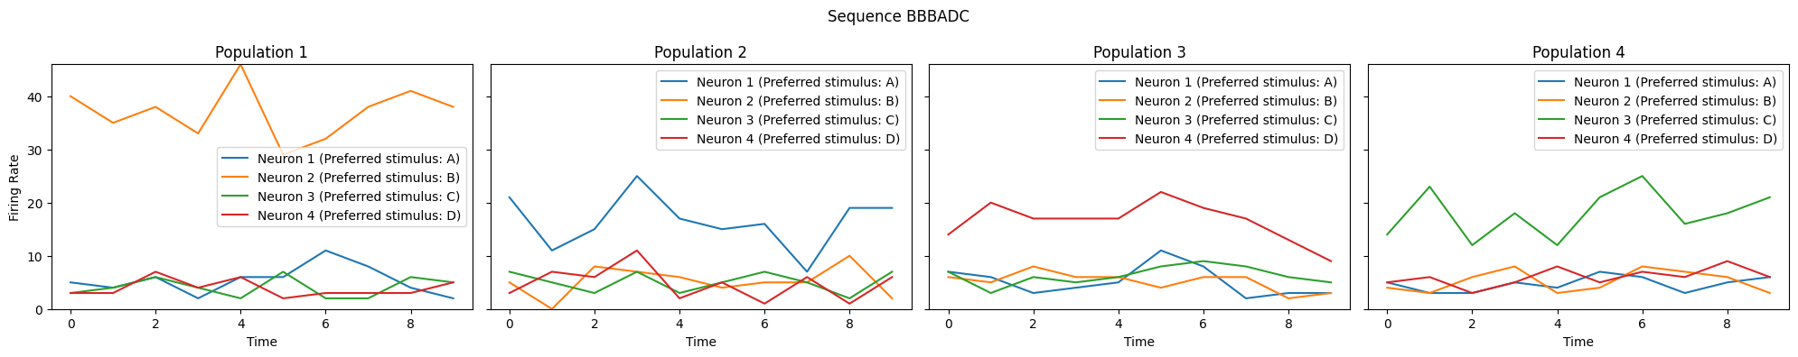
Slot model implementation
Example sequence BBBADCBDA
Behavioral Prediction:
-BBBADC
Neural Prediction:
-Discrete populations for ordinality
-Modulated firing rate for repeats

Slide 16
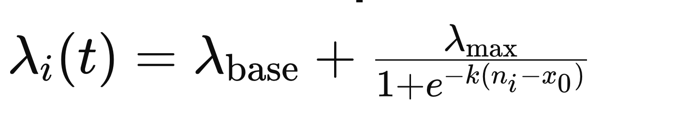
Temporal Model
Temporal model’s constraint: Time
How to encode chunking of repeats in the temporal switching model? Firing rate
.2 sec
.2 sec
.2 sec
.2 sec

Slide 17
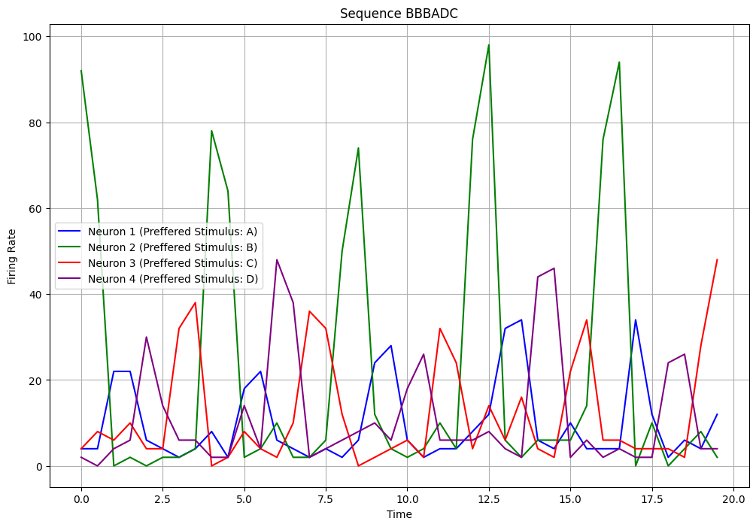
Temporal Model Implementation
Example sequence BBBADCBDA
Behavioral Prediction:
-BBBADC
Neural Prediction:
-Cyclical neural activity
-Modulated firing rate for repeats

